Slide 1

Sussurros do Universo: o Projeto BINGO
Whispers of the Universe: the BINGO project
Elcio Abdalla

Slide 2
A Física Teórica
Theoretical Physics
Looking at the world and understanding it has always been part of the civilizing challenge
The perspectives have always been as much about inspiration as the practical world: technology
Olhar para o mundo e compreendê-lo sempre foi parte do desafio civilizatório
As vertentes sempre foram tanto relativas à inspiração quanto ao mundo prático: tecnologia

Slide 3
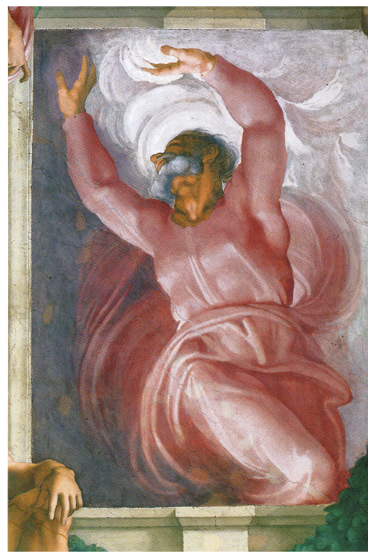
A criação do universo
The Creation of the Universe

Slide 4
O Mito do Saber Consciente ...
The Myth of the Conscious Knowledge

Slide 5
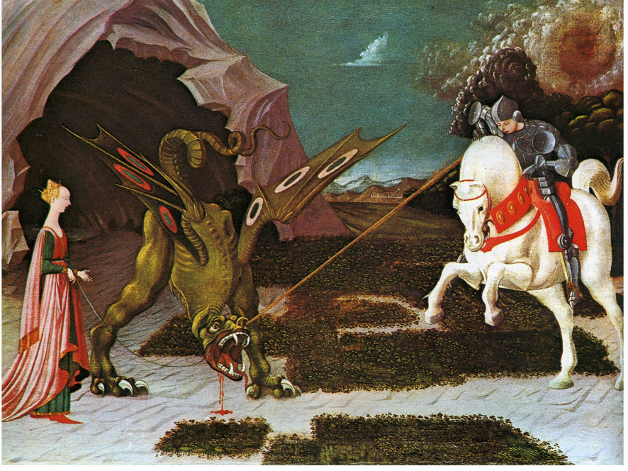

Slide 6
A Aurora dos Conhecimentos Científicos sobre a Natureza
The Dawn of the Scientific Knowledge about Nature

Slide 7
A Terra Redonda
The Round Earth
Dias mais longos em altas latitudes, fato conhecido entre os antigos gregos
Heródoto: fenícios circumnavegaram a África com Sol à direita ao irem para Oeste.
A idéia de Terra redonda: século quinto A.C.
Longer days at high latitudes known to the ancient Greeks
Herodotus: Phoenicians circumnavigated Africa with sun on the right as they went west.
The idea of Round Earth: fifth century A.C.

Slide 8

O Universo em Tempos Imemoriais.
The Universe at Imemorial Times

Slide 9
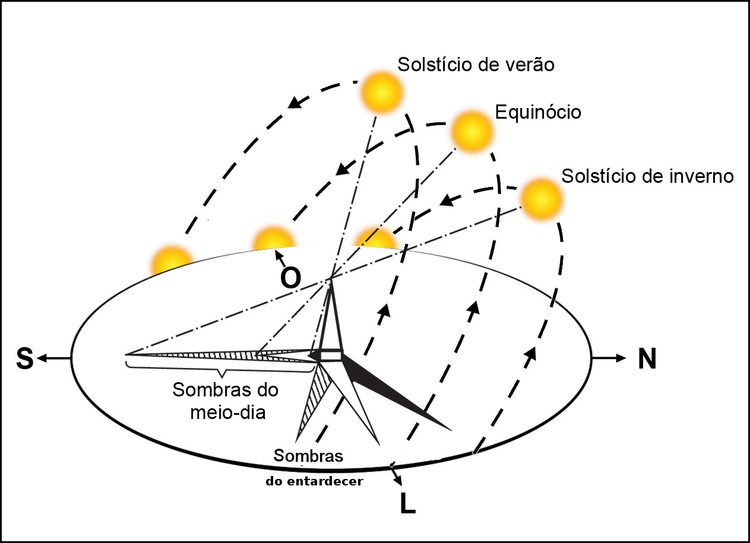
Movimentos do Sol
Sun´s Movements

Slide 10
As Medidas de Tempo
Time Measurements
Primeiras observações: tempo e sua medida
O movimento das estrelas: perfeito para tempos curtos
Período de 23 h 56 min (360 x 4 min corresponde a cerca de um dia)
First observations: time and its measurement
The movement of the stars: perfect for short times
23 h 56 min period (360 x 4 min corresponds to about one day)

Slide 11
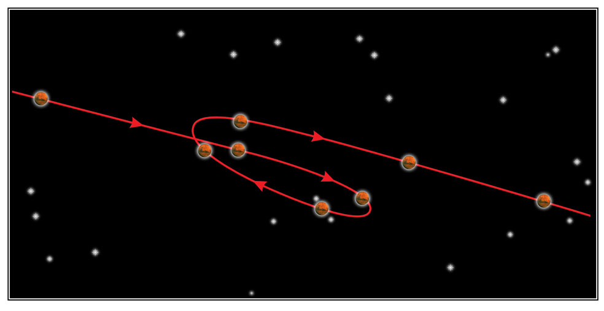
Movimento Planetário
Planetary Movements

Slide 12
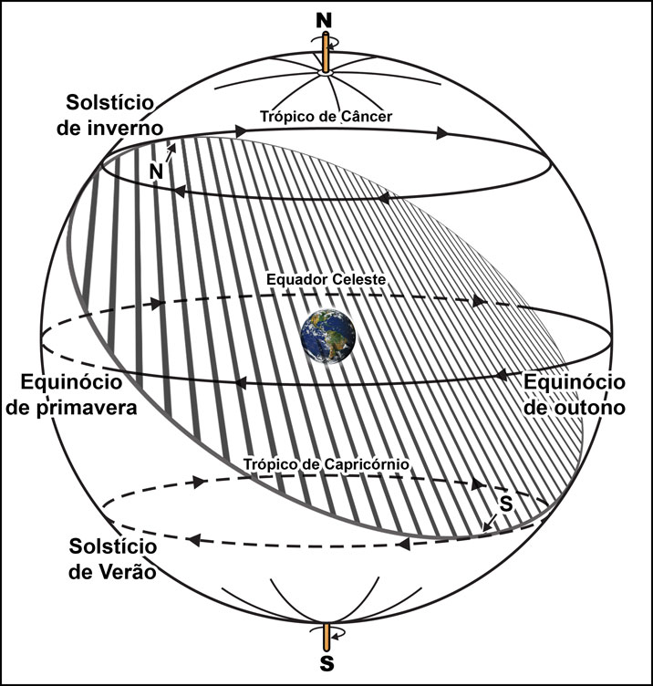
A Esfera Celeste
The Celestial Sphere

Slide 13
Medidas de Distância
Distance Measurements
Raio da Terra por Eratóstenes
Sol a pino em Alexandria
Medida da sombra em Siena (a 5000 estádios)
Eratóstenes achou 250.000 estádios
Resultado correto em 5% (excelente!)
Distância à Lua e ao Sol estimadas por Aristarco
Earth Radius by Eratosthenes
Sun at vertical line above in Alexandria
Shadow measurement in Siena at 5000 stadia
Eratosthenes found 250,000 stadia
Correct result at 5% (excellent!)
Distance to the Moon and Sun estimated by Aristarco

Slide 14
Calendário
Calendar
Calendário Juliano, Julio Cesar, astrônomos Egípcios
Avanço da Páscoa
Copérnico: hipótese heliocêntrica.
Eliminação de alguns anos bissextos e de alguns dias:
Calendário Gregoriano (1582)
Julian Calendar, Julio Cesar, Egyptian astronomers
Easter Advance
Copernicus: heliocentric hypothesis.
Elimination of a few leap years and a few days in 1582
Gregorian Calendar (1582)

Slide 15
The Copernican Revolution
A Revolução de Copérnico

Slide 16
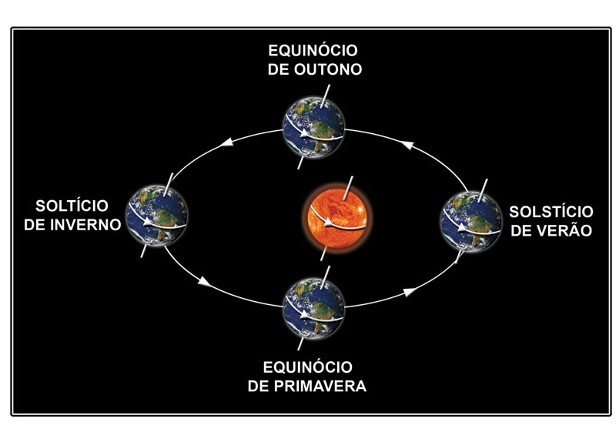
Estações do Ano (Sul) e Movimento da Terra
Year´s Seasons and the Movement of the Earth

Slide 17
Johannes Kepler *1571 ⁺1630
Tycho Brahe *1546 +1601
Galileo Galilei *1564 ⁺1642
Isaac Newton *1642 ⁺1727

Slide 18

Em Direção à Modernidade: a Queda da Física Clássica
Toward Modern Times: the Fall of Classical Physics

Slide 19
Incompatibilidade entre o Eletromagnetismo e a Mecânica Clássica
Incompatibility between Electromagnetism and Classical Mechanics
Transformações de Lorentz ao invés de Galileo
Conseqüência: Geometria de Minkowski em 4 dimensões
Tempo não é absoluto
Lorenz instead of Galilean Transformations
Consequence: Minkowski geometry in 4 dimensions instead of euclidian 3 dimensions
No absolute time

Slide 20
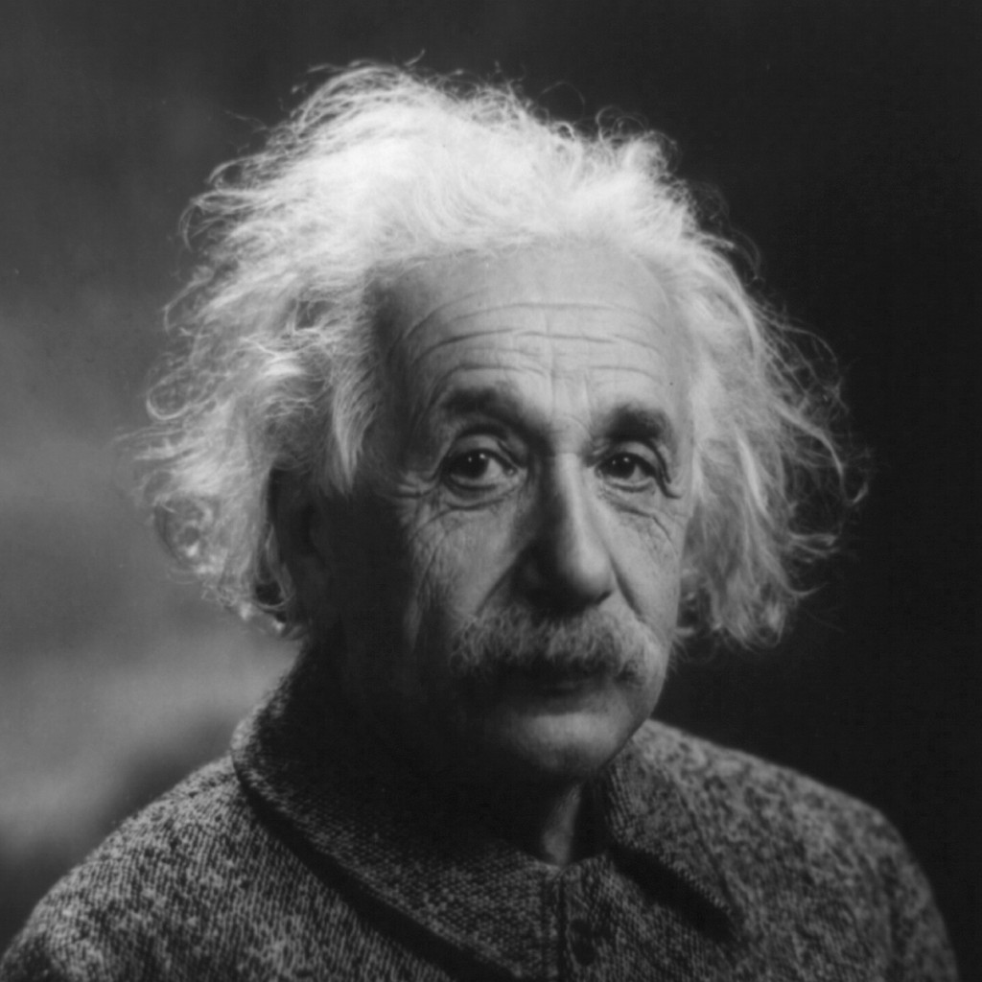
Albert Einstein *1879 ⁺1954

Slide 21
Relatividade Especial
Special Relativity
Einstein: postulou geometria de Minkowski para a Mecânica
Reinterpretação do espaço-tempo
Einstein: postulated Minkowski geometry for Mechanics
Reinterpretation of space-time
Relatividade Geral
General Relativity
O princípio da Equivalência
Geometria como descrição da gravitação
As Equações de Einstein
The Equivalence Principle
Geometry as a description of Gravity
Einstein Equations

Slide 22
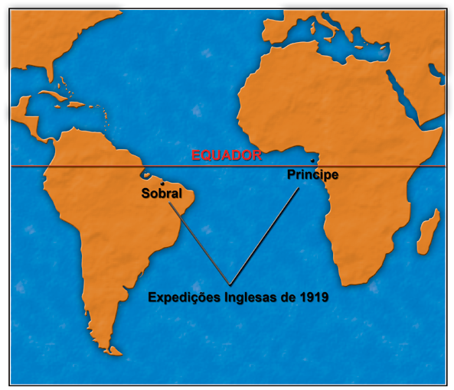

Slide 23
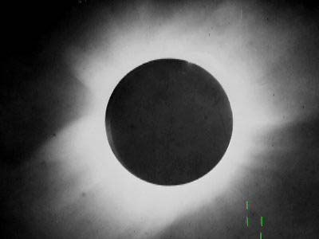

Slide 24
A Teoria da Relatividade Geral
General Relativity
O Princípio Cosmológico
A solução de Friedmann-Lemaître-Robertson-Walker
O Universo em expansão
Buracos Negros
The Cosmological Principle
Friedmann-Lemaître-Robertson-Walker Solution
The Expanding Universe
Black Holes

Slide 25

Em direção ao Cosmos
Toward the Cosmos

Slide 26
O Princípio Cosmológico
The Cosmological Principle
As várias partes do Universo são equivalentes a menos de detalhes. Portanto, o Universo deve ser formado por
The various parts of the Universe are equivalent to less detail. Therefore, the Universe must be formed by
Homogeneous Universal Cosmic Fluid + Perturbations
Fluido cósmico universal homogêneo + Perturbações

Slide 27
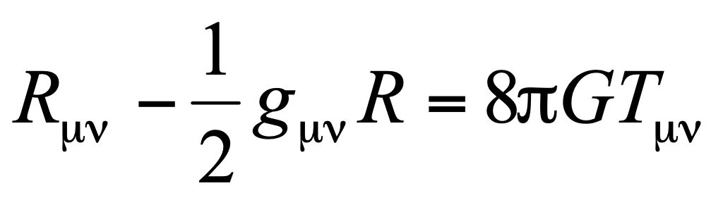
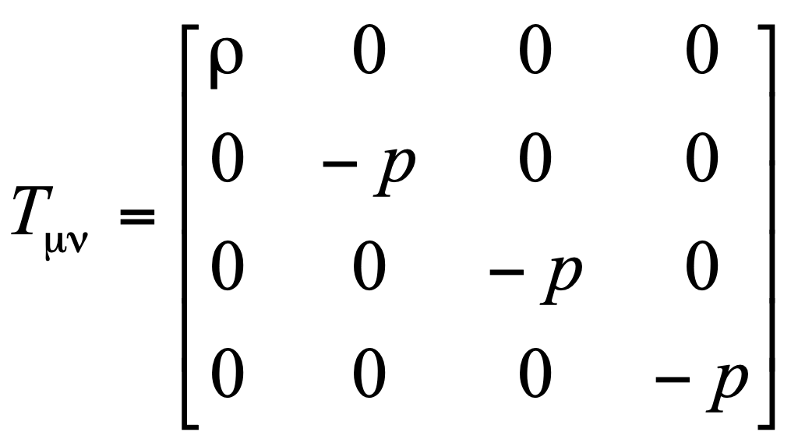
Equações Cosmológicas
Cosmological Equations
Seja ρ(t) a densidade média de matéria do Universo, e p(t) a pressão correspondente.
Let ρ(t) be the average density of theUniverse and p(t) the pressure:
Equações de Einstein:
onde

Slide 28
Expansão do Universo: Lei de Hubble
Expansion of the Universe: the Hubble law
O Parâmetro de Hubble significa que o Universo está se expandindo. A imagem é de que estamos em uma enorme estrutura (o universo) que se está inflando!
The Hubble parameter implies expansion. We are in na enormous expanding structure, the Universe!
Hoje: H= 70 km/seg Mpc, ou seja, uma galáxia a uma distância de 10 Mpc está se distanciando de nós a cerca de 700 km/s; 1pc =3.2 anos luz
Em uma equação, escrevemos
V = H d
Today: H=70 km/sec Mpc, i.e., a galaxy at a distance 10 Mpc, flies aways at the speed of 700 km/sec. 1pc=3.2 light Years.
As an equation:
V=Hd

Slide 29

O Cosmos
The Cosmos

Slide 30
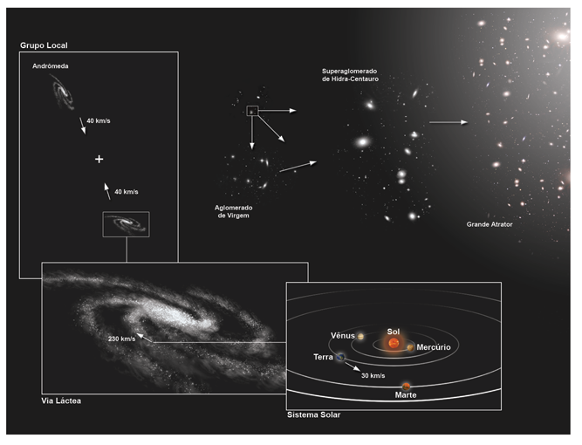
O Universo e suas escalas de distância
The Universe and its distance ladder

Slide 31
O Universo e seu tamanho
The Universe and its size
Raio da Terra: 6.400 km
Terra Lua: 300.000 km (1 seg-luz)
Terra Sol 150 Mkm (8 min-luz)
Sol Plutão 6 bilhões km (6 h-luz)
Alfa Centauri 4 Anos luz
Via Láctea 30 kpc ~ 100.000 anos luz
Andrômeda (1 trilhão estrelas)
2.5 M A luz 750 kpc
Aglomerado Virgem
7.5 M a.l., 2.4 Mpc
SuperAglomerado Virgem
200 M a.l., 60 Mpc
Universo 15 billion l.y. = 5 Gpc
Earth Radius: 6.400 km
Earth-Moon: 300.000 km (1 light-sec)
Earth Sun150 Mkm (8 light-min)
Sun-Pluto 6 billion km (6 light-hour)
Alfa Centauri 4 light-years
Milk Way 30 kpc ~ 100.000 light-y
Andromeda (1 trillion stars)
2.5 M light-y=750 kpc
Virgo Cluster 7.5 M l.y = 2.4 Mpc
Virgo Super-cluster 200 M l.y., 60 Mpc
Universe 15 billion l.y. = 5 Gpc?

Slide 32
O Início do Universo: a História Cósmica e os menores Elementos
The Beginning of the Universe: Cosmic History and the Smallest Elements

Slide 33
Sobras do Big Bang
Remains of the Big-Bang
Radiação Cósmica de Fundo, 2.7K
Prevista na década de 40
Descoberta: Penzias e Wilson 60
Analisada pelo satélite COBE
Analisada pelo satélite WMAP
Analisada por balões sobre pólo Sul
Analisada recentemente pelo satélite Planck
Cosmic Microwave Background, 2.7K
Foreseen in the 40´s
Found: Penzias e Wilson 60
Analised by the COBE satelite
Analised by WMAP satelite
Analised by baloons over the South pole
Analised recently by the Planck satelite

Slide 34

Novas Observações e o Futuro Cosmológico
New Observations and the Cosmological Future

Slide 35
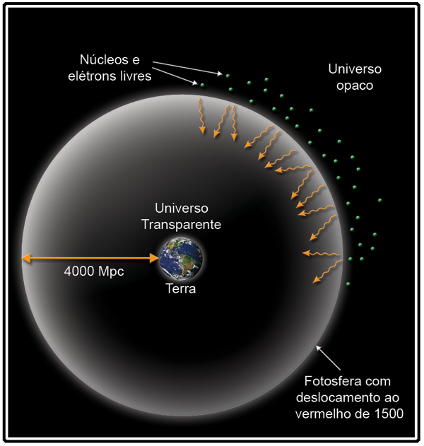
Cosmic Background Radiation
Radiação Cósmica de Fundo

Slide 36
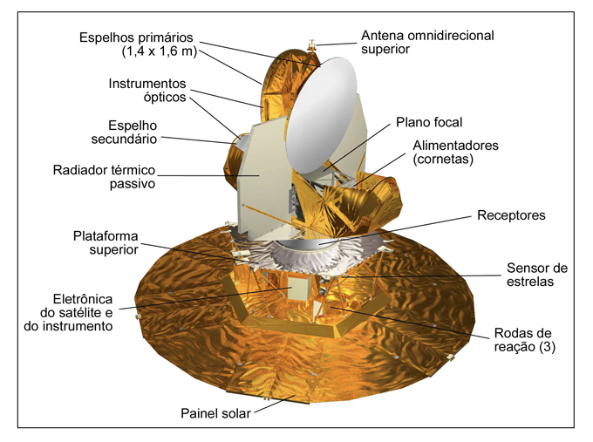
WMAP: new probe to measure the background radiation
WMAP: nova sonda para medida da radiação de fundo

Slide 37
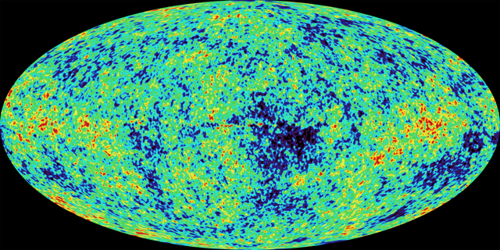
Cosmic Background Radiation: WMAP
Radiação Cósmica de Fundo: WMAP

Slide 38
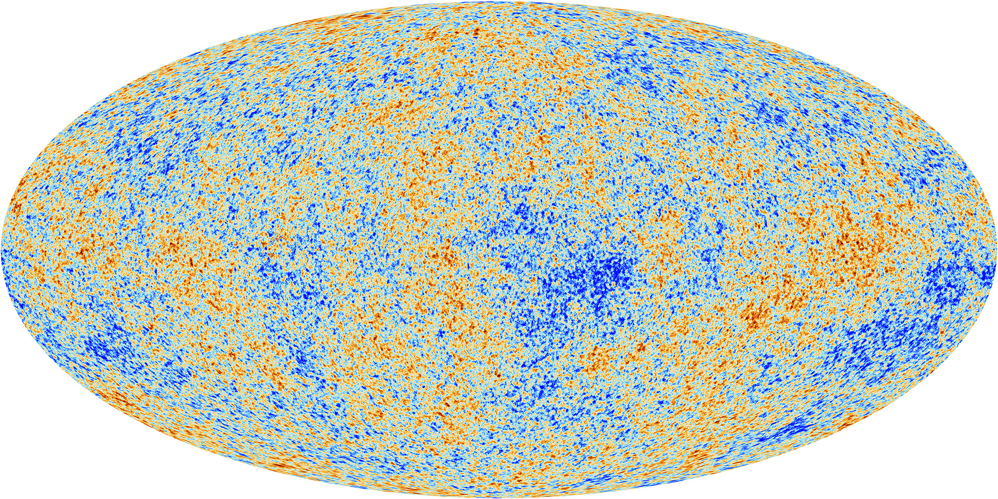
Radiação Cósmica de Fundo: Planck
Cosmic Radiation Background:
Planck

Slide 39
Consequências de Wmap/Planck
Consequences of
Wmap/Planck
Medidas de grande precisão em cosmologia
Confirmação da existência de matéria escura e de energia escura: 95% do universo é formado por algo totalmente desconhecido!!!
Precision measurements in Cosmology
Confirmation of the existence of a Dark Sector: 95% of the Universe contente is largely unknown!!!

Slide 40
Dark Matter
Matéria escura
Componente misterioso em grandes aglomerados matéria.
Atraem mais fortemente do que deveriam, contendo mais matéria, dez vezes mais que o observado através da luz emitida!
A causa dessa atração é denominada matéria escura.
Indícios da Matéria Escura:
Espectro da radiação cósmica de fundo
As medidas de matéria associada a galáxias
There's a mysterious component in large clusters of matter.
These attract more strongly than they should, containing more matter, ten times more than that observed through the emitted light!
The cause of this attraction is called dark matter.
Dark Matter Clues:
Spectrum of cosmic background radiation
Measurements of galaxy-associated matter

Slide 41
Dark Energy
Energia escura
HOJE o universo está em aceleração!
A causa da expansão acelerada é denominada energia escura.
As indicações observacionais são:
As observações de Supernovas 1A
O espectro da radiação cósmica de fundo (RCF)
TODAY the universe is accelerating!
The cause of accelerated expansion is called dark energy.
Observational indications are:
The observations of 1A Supernovae
The spectrum of cosmic background radiation (RCF)

Slide 42
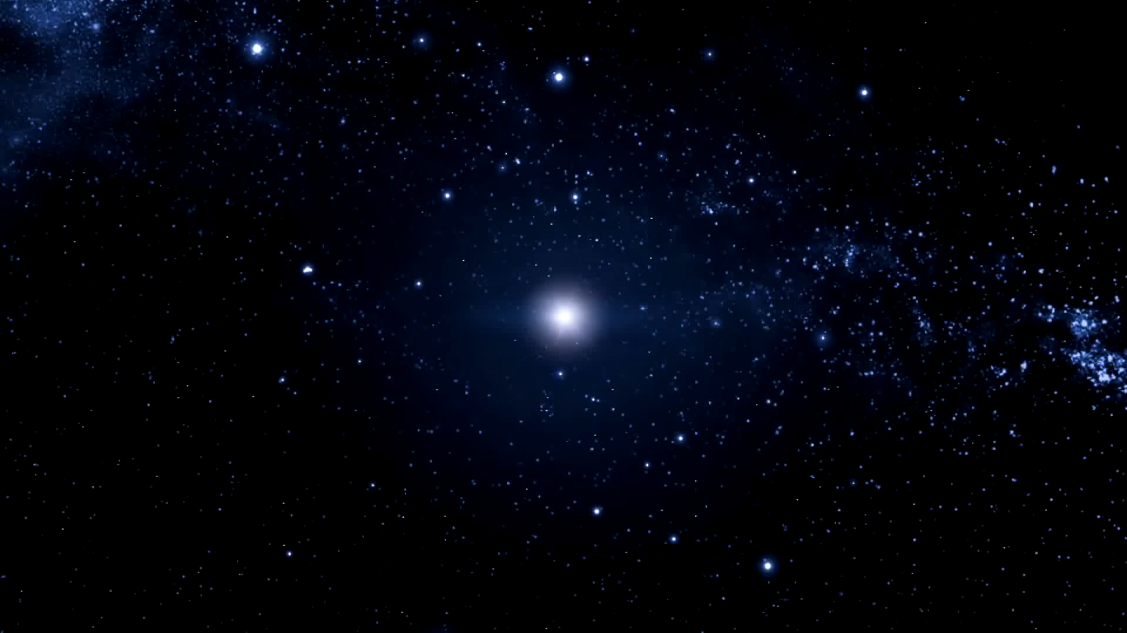
Explosão de Supernova
Supernova Explosion

Slide 43
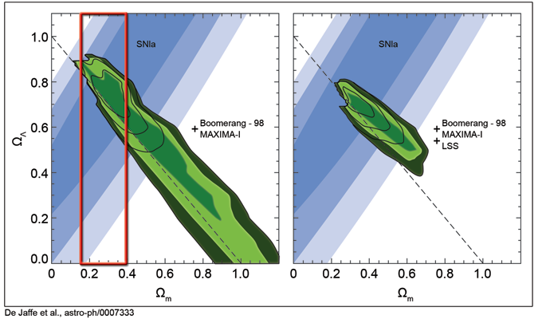
Concluimos que …
We conclude that…

Slide 44
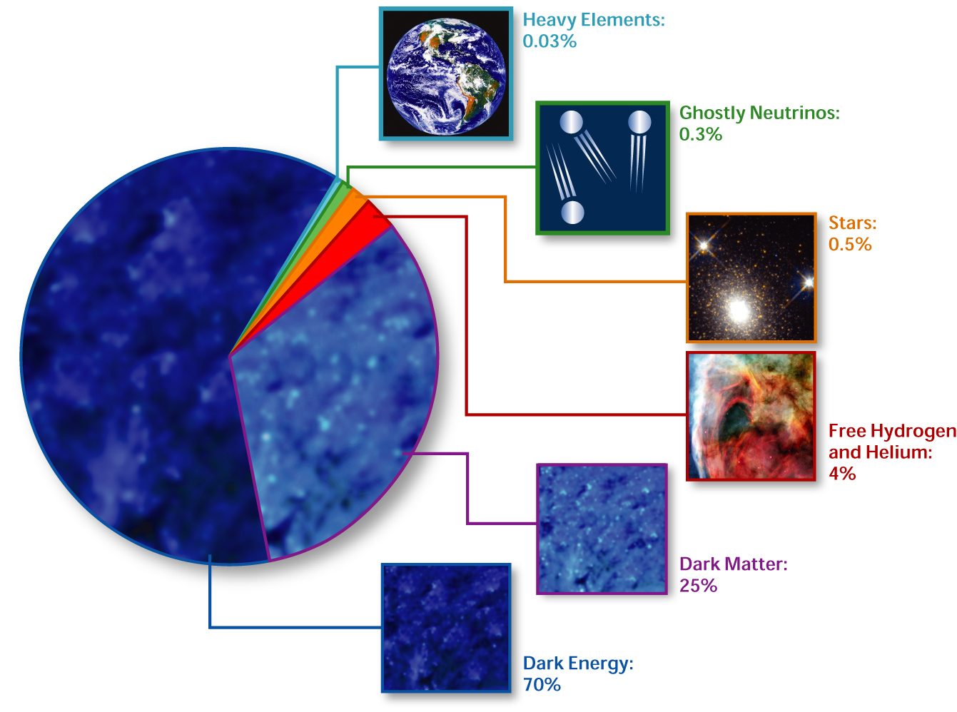
O Modelo Cosmológico Padrão Composição do Universo
http://en.wikipedia.org/wiki/Image:Cosmological_composition.jpg source and rights]
Elcio Abdalla-Interacting Dark Energy

Slide 45
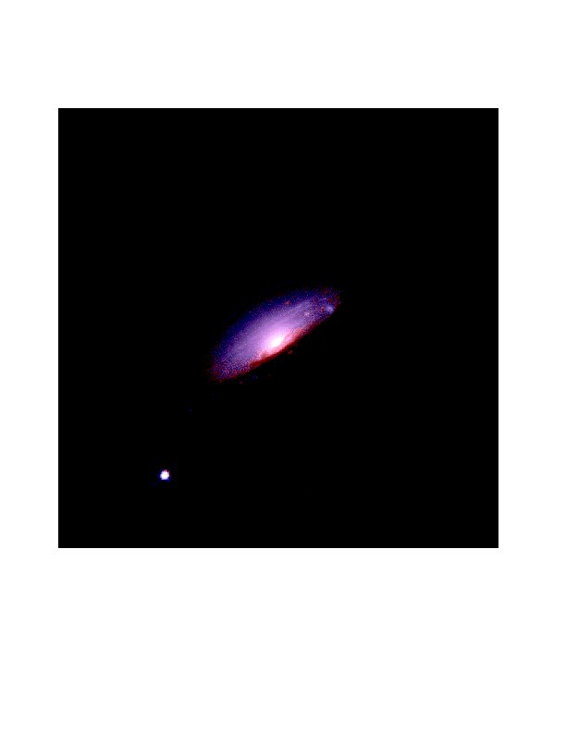
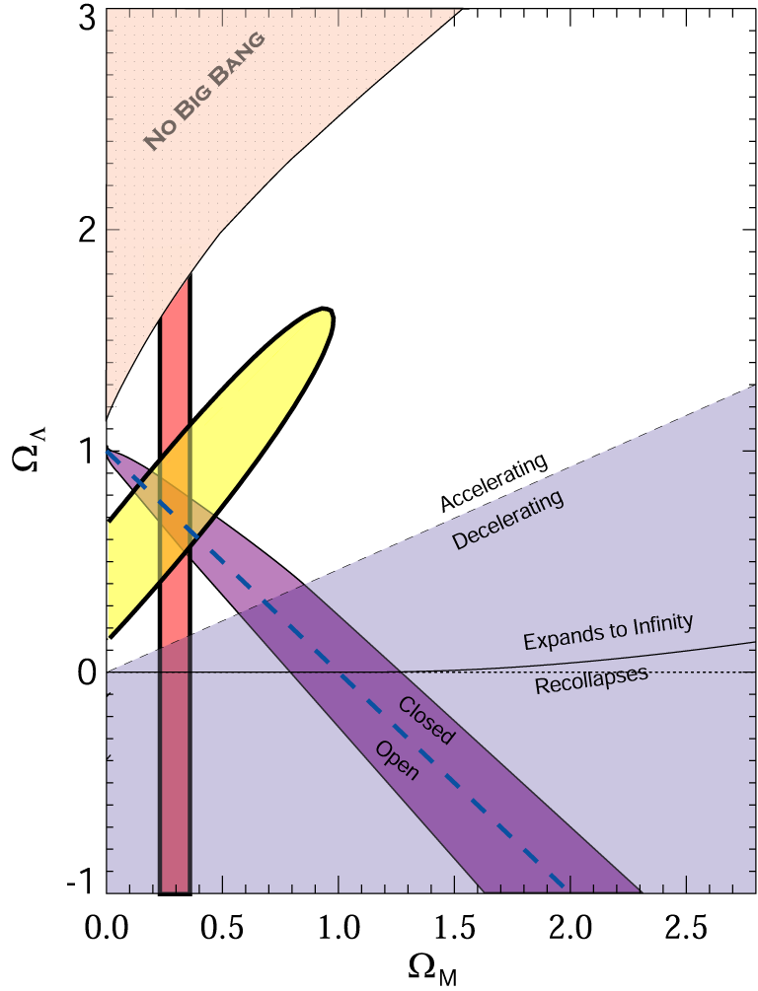
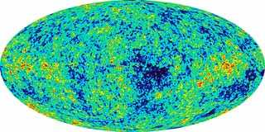
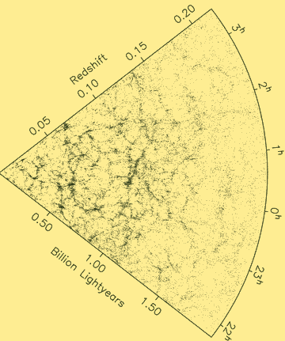
O que é a Energia Escura?
Evidência:
98's: Universo se expande aceleradamente.
CMB
SNe Ia
Ω_{DE}=0.721±0.025 (WMAP)
WMAP
LSS
Ω_{DE}=0.685±0.013 (Planck)
Source: S. Tsujikawa, “Dark Energy and Modified Gravity"

Slide 46
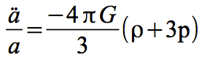
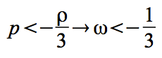
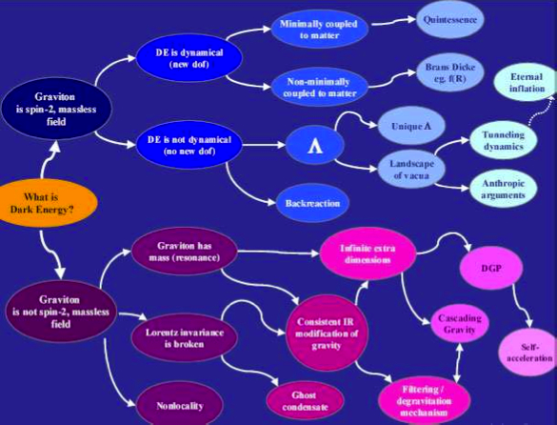
O que causa a aceleração?
Das equações de Einstein:
Elcio Abdalla-Interacting Dark Energy
Source: de Rahm & Tolley, 2008

Slide 47
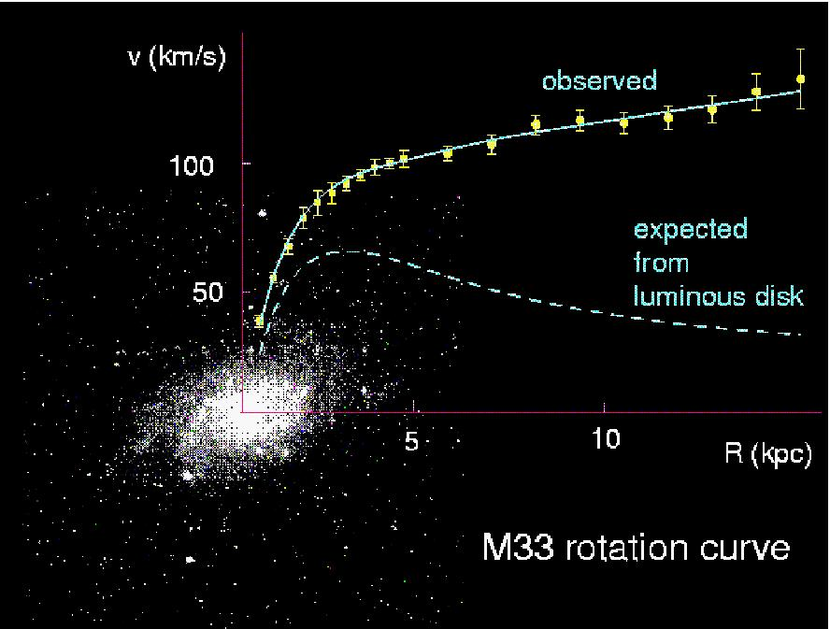
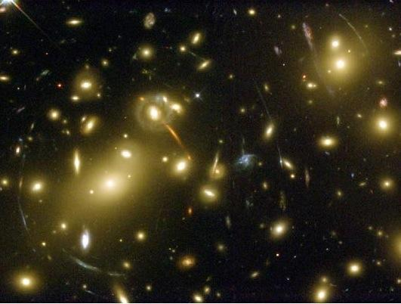
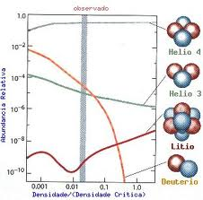
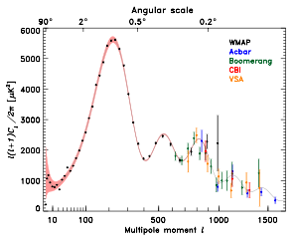
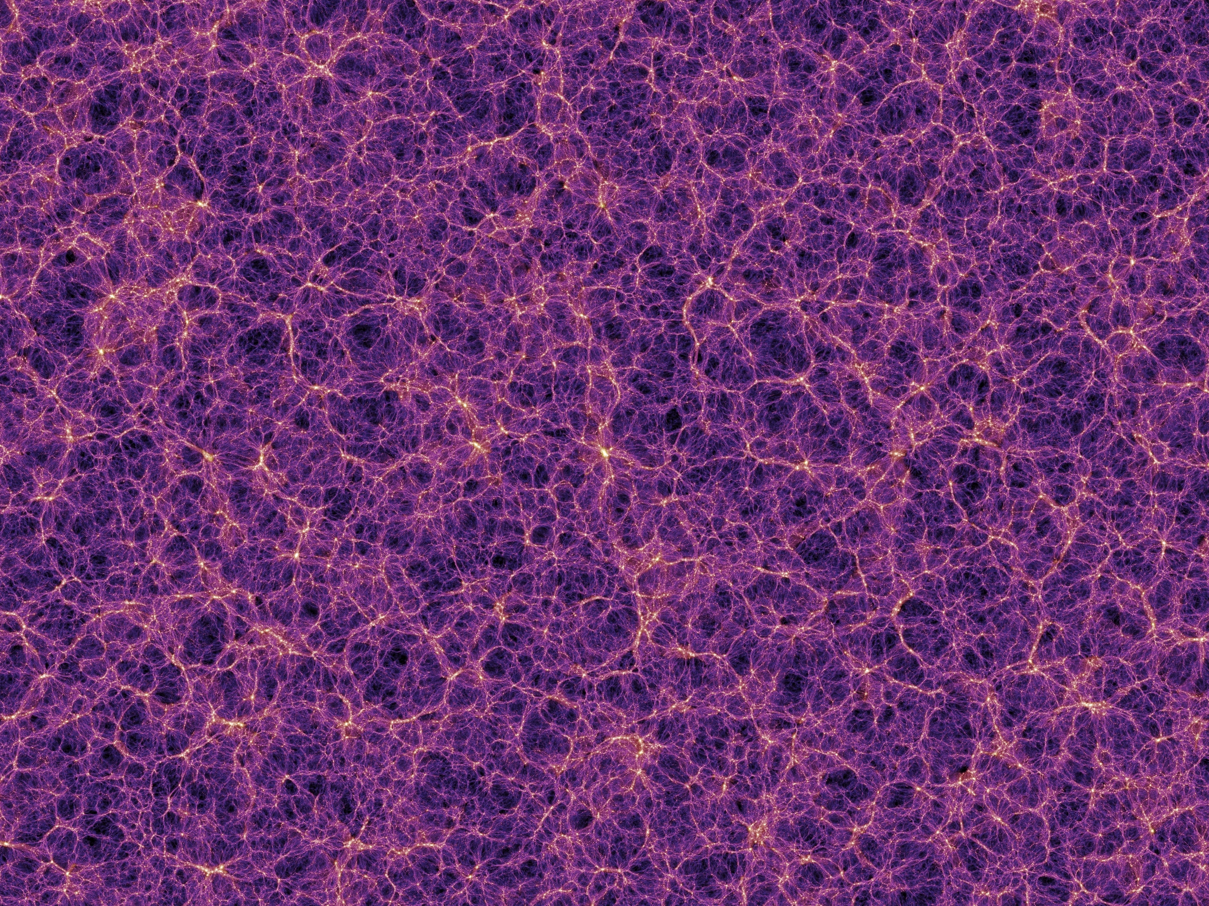
O que é a Matéria Escura?
Evidências extensas mostram que há um tipo de líquido transparente sem cor e sem contato
Um imenso mistério!!! Mas bem medido!!! Bem Observado!!!
Elcio Abdalla-Interacting Dark Energy

Slide 48
A Estrutura do Setor Escuro
The Structure of the Dark Sector
Matéria e Energia Escura são só líquido transparente e constante?
Haveria uma Estrutura no Setor Escuro?
Há muitos trabalhos neste sentido (E. Abdalla, Bin Wang e outros)
O Setor Escuro admite complexidade?
Dark Matter and Dark Energy are just transluscid liquid and a constant?
Is there a strusture in the Dark Sector?
There are several scientific papers in this direction (E. Abdalla, Bin Wang et al)
Does the Dark Sector admit complexity?

Slide 49
Oscilações Acústicas de Bárions
Baryon Acoustic Oscillations
Photons e Bárions formavam um gás denso e quente, com muitas ondas, em vista da interação e da inércia.
380.000 anos após o Big-Bang o Universo tornou-se transparente e estas ondas congelaram
Havendo pontos em que as ondas eram maiores, houve ali atração de matéria
Photons and Bárions formed a dense, hot gas, with many waves, in view of interaction and inertia.
380,000 years after the Big-Bang the Universe became transparent and these waves froze
If there were points where the waves were bigger, there was attraction of matter

Slide 50
Oscilações Acústicas de Bárions
Baryon Acoustic Oscillations
Estas ondas nos mostram a geometria intrínseca do Universo
Portanto, ela nos levam a vínculos sobre os parâmetros das Equações de Einstein.
Com isto, temos informações mais seguras sobre a estrutura do Setor Escuro do Universo
Afinal ondas são gigantescos movimentos de matéria
These waves show us the intrinsic geometry of the Universe
Therefore, it leads us to links on the parameters of Einstein's Equations.
With this, we have more secure information about the structure of the Dark Sector of the Universe
After all waves are gigantic movements of matter

Slide 51
Oscilações Acústicas de Bárions
Baryon Acoustic Oscillations
As Oscilações Acústicas de Bárions são ondas de 500 milhões de anos luz de comprimento.
São impossíveis de serem percebidas em uma análise ingênua.
O uso de métodos sofisticados de estatística é necessário
The Baryon Acoustic Oscillations are waves 500 million light years long.
They are impossible to be perceived in a naïve analysis.
The use of sophisticated statistical methods is necessary

Slide 52
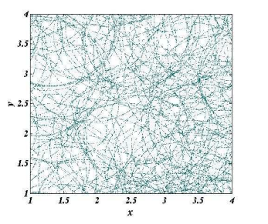

Slide 53
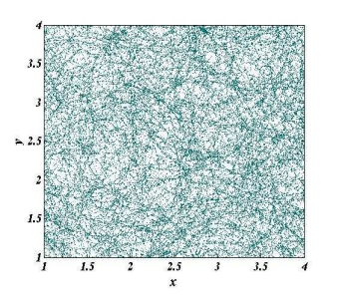

Slide 54
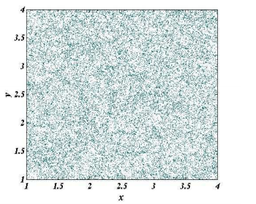

Slide 55
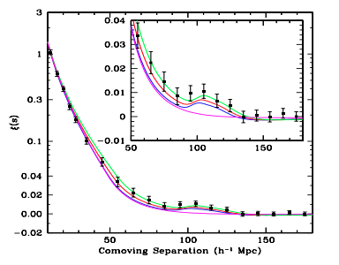

Slide 56
O Projeto BINGO:
Primeiras Ideias
The BINGO Project:
The first Ideas
Primeiros contatos com Univ. de Manchester em 2010/2011
Possibilidade de Medida do Setor Escuro
Comparação com Pólo Sul Celeste para Eliminação de ruídos
Procura de Sítios no Uruguai
First contacts with Manchester University in 2010/2011
Possibility of Dark Sector Measurement
Comparison with Celestial South Pole for Noise Elimination
Search for Sites in Uruguay

Slide 57
O Projeto BINGO:
Primeiras Ideias
The BINGO Project:
The first Ideas
Procura posterior de sítios no Brasil
Escolha da Paraíba: melhor sítio e melhor colaboração
Universidade Federal de Campina Grande
Further search for sites in Brazil
Choice of Paraíba: best site and best collaboration
Federal University of Campina Grande

Slide 58
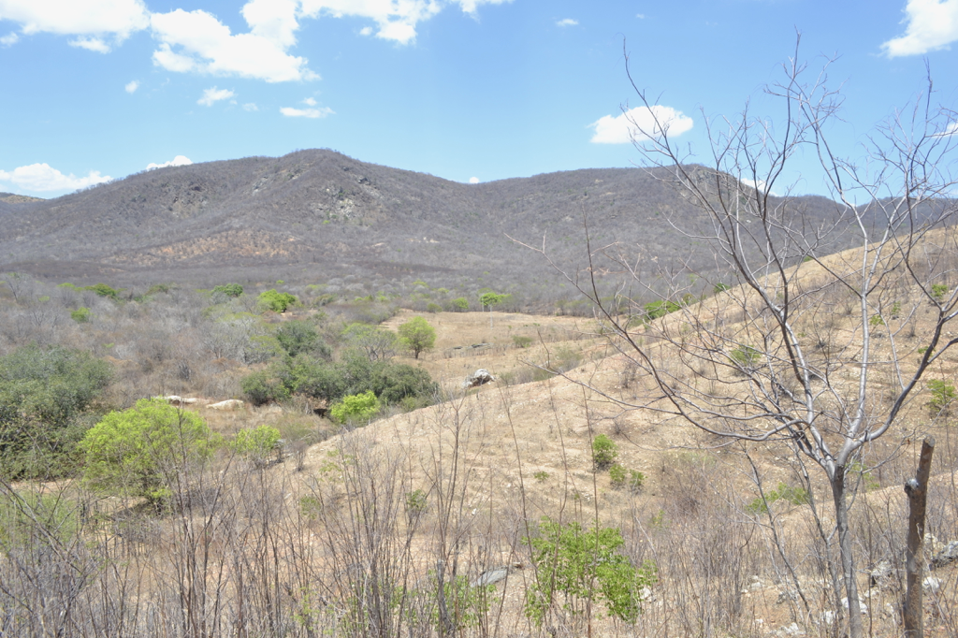
Serra do Urubu
Urubu (Vulture) Hills

Slide 59
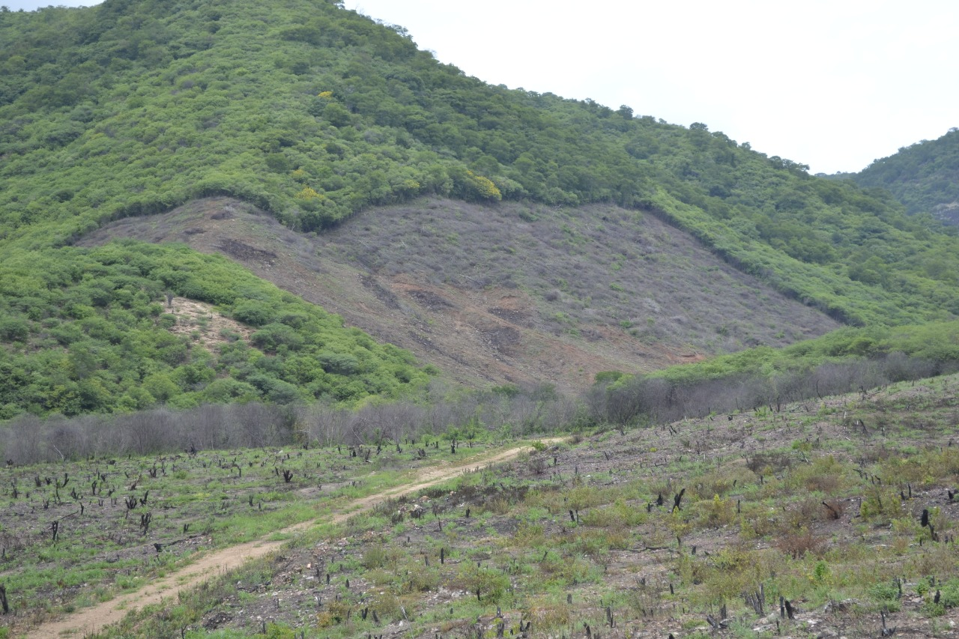

Slide 60
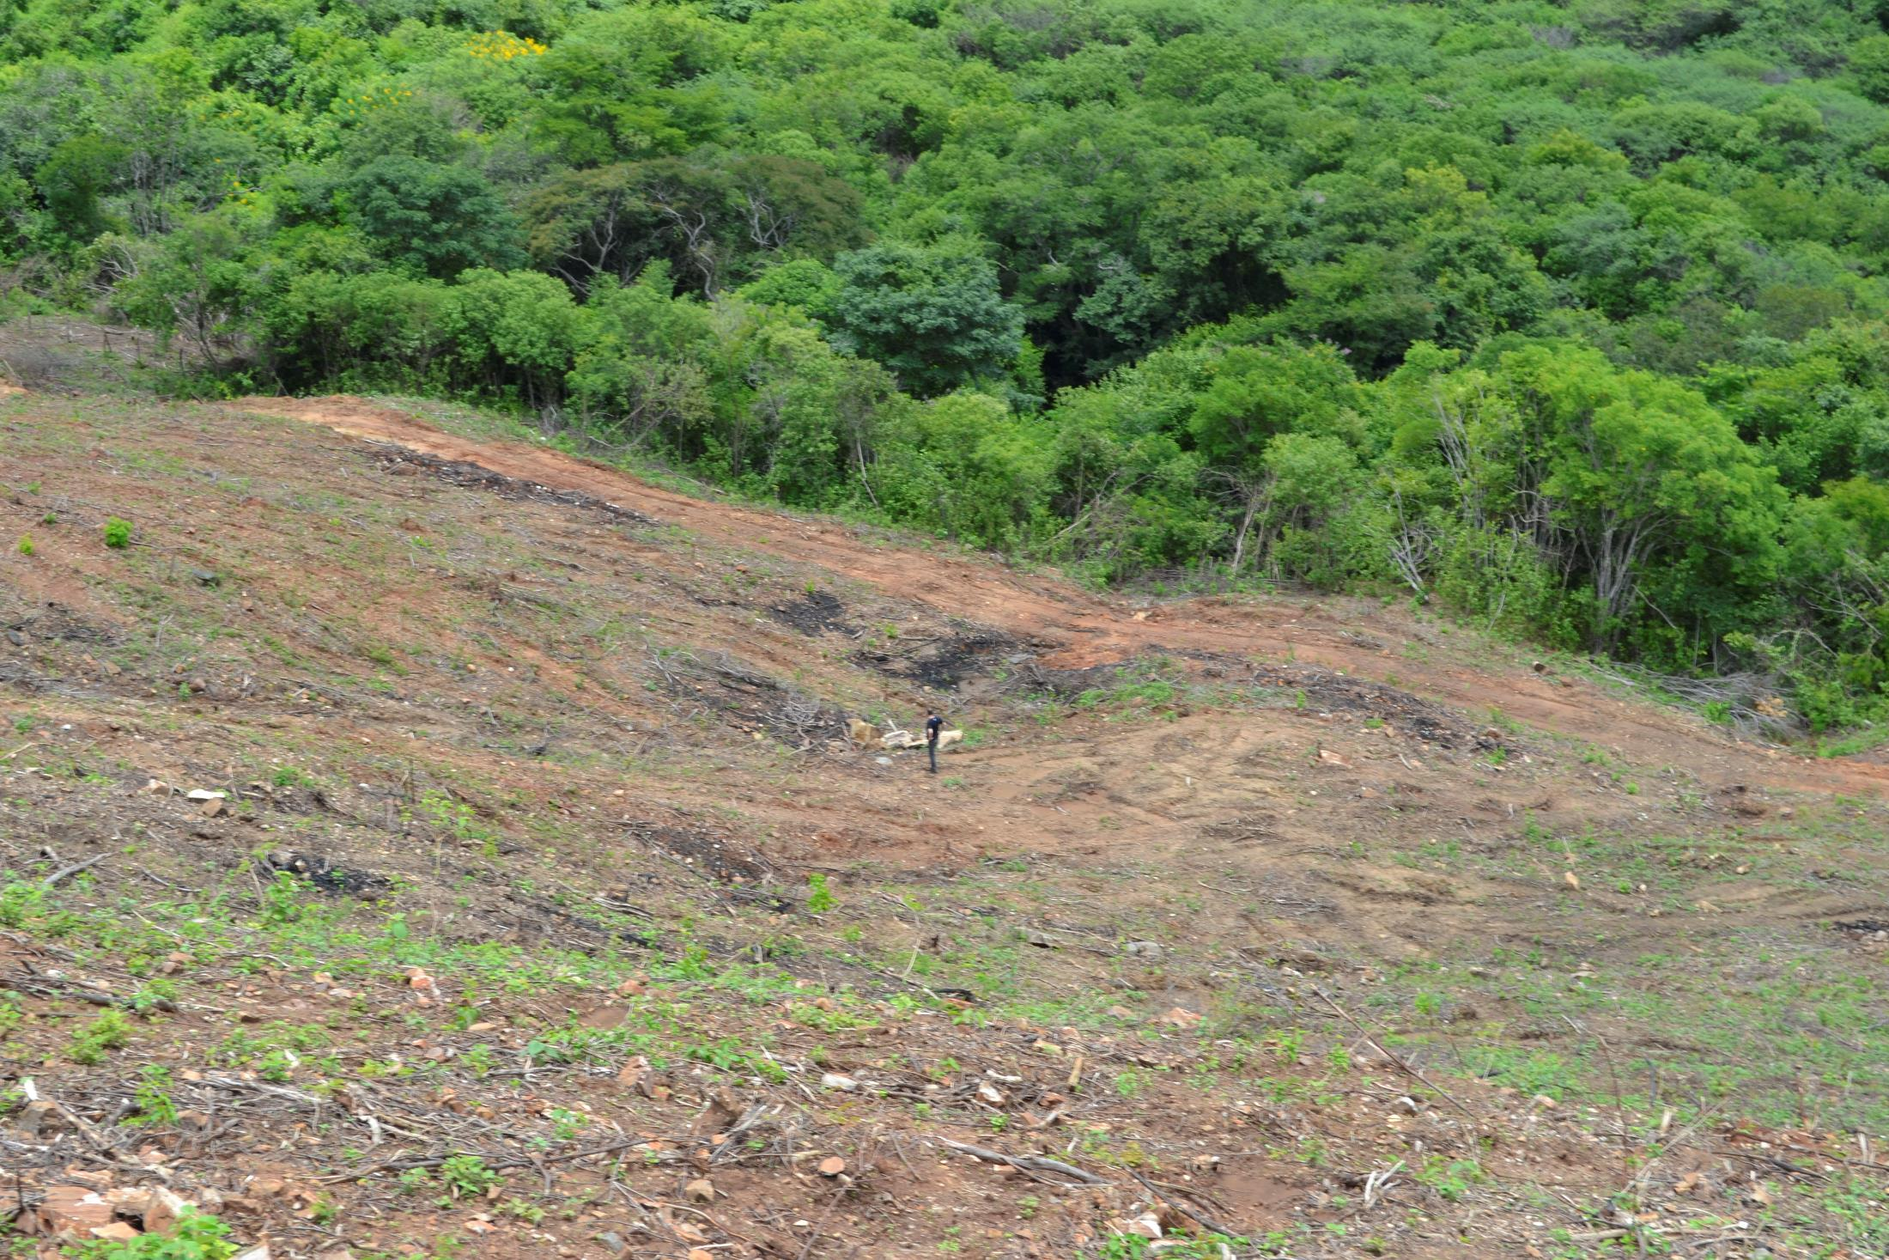

Slide 61
O Projeto BINGO
The BINGO Project
Mapeamento de Intensidade
O início da preponderância da Energia Escura
Uma nova técnica de captação
Recursos: FAPESP, China, MCTI
Mais recursos: governo da Paraíba, FINEP
Iniciativa privada?
Intensity Mapping
The beginning of the Dark Energy era
A new capture technique
Resources: FAPESP, China, MCTI
More resources: Government of Paraíba, FINEP
Private enterprise?

Slide 62
O Projeto BINGO:
Primeiras Ideias
The BINGO Project:
The first Ideas
Haveria possibilidade de outros recursos?
De qualquer modo o Projeto está avançando
As cornetas vão sendo construídas (ver seminário Prof. C.A. Wuensche)
Outros aspectos estão preparados: outriggers (forquilhas) para detecção das Rajadas rápidas de Rádio.
Futuro: extensões do BINGO
Would there be any possibility of other resources?
In any case, the Project is advancing
Horns are being built (see Seminar Prof.C.A. Wuensche)
Other aspects are prepared: outriggers for detection of fast radio bursts.
Future: BINGO extensions

Slide 63



BINGO-ABDUS
SCIENCE, TECHNOLOGY, SCIENTIFIC EDUCATION, AND DEVELOPMENT
Elcio Abdalla

Slide 64

Aim
science
Technology
Education
Development

Slide 65


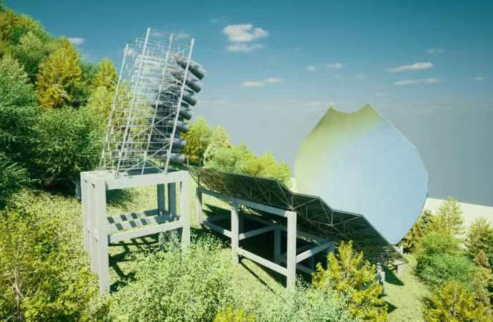

BINGO
International Colaboration
CHINA-BRASIL leadership
Dark Matter and Dark Energy
Pulsars
Quasars
Fast Radio Bursts
Local industry development
Science as source of educational development

Slide 66

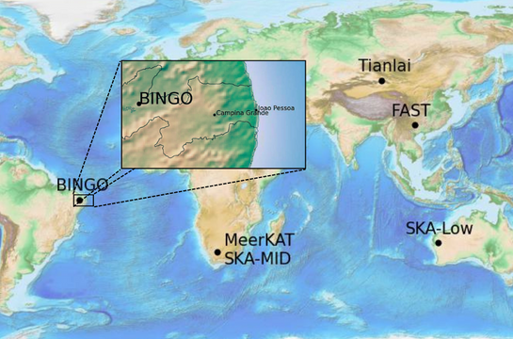
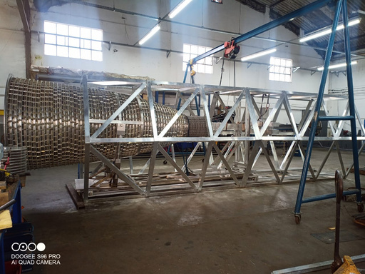
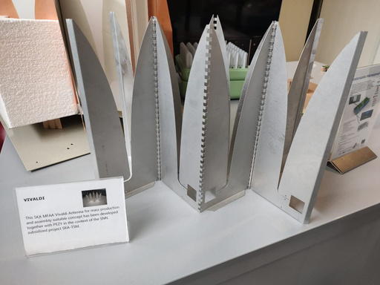
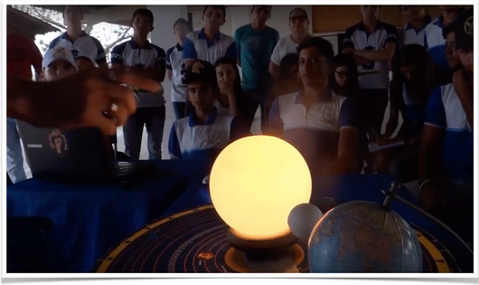


BINGO-ABDUS
South Hemisphere
Industry
Innovation
Knowledge
North East of Brazil
Isolated area with low RFI
Universities collaboration
Scientific goals together with industry development.
New techniques of observation
Remote Sensoring
Telecomunication
Scientific culture Spread
Higher Education
Especialized labour
Science development

Slide 67



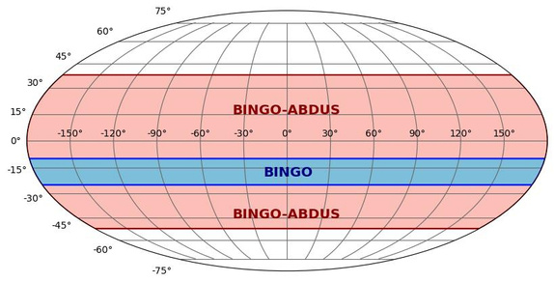

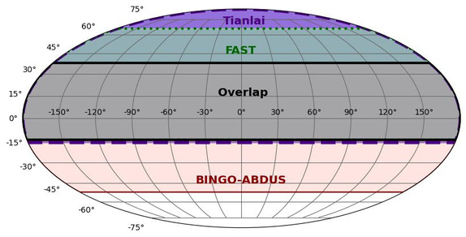
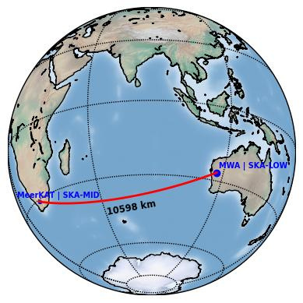
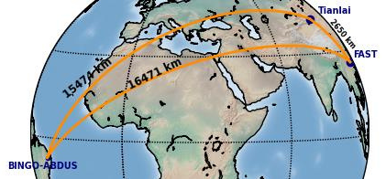
BINGO 5324 degree²/ 28 beams /40 arcmin
BINGO-ABDUS 32400 degree²/ 200 beams/2.5 arcseg
BINGO-ABDUS + FAST + TIANLAI
Coverage: 18846 degree²
Baselines: 2.650km x 15.464km x 16.471km

Slide 68











一
Remote sensoring
二
Chips Development
三
Hongmeng Project

Slide 69

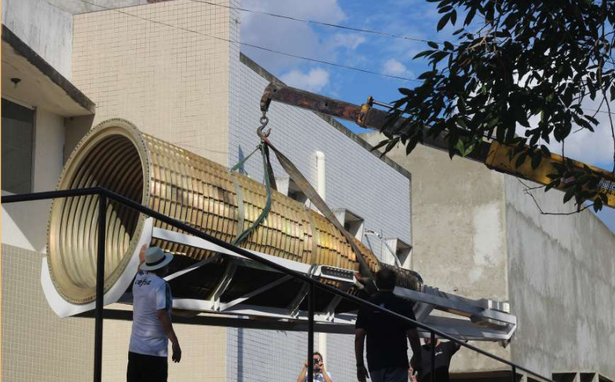
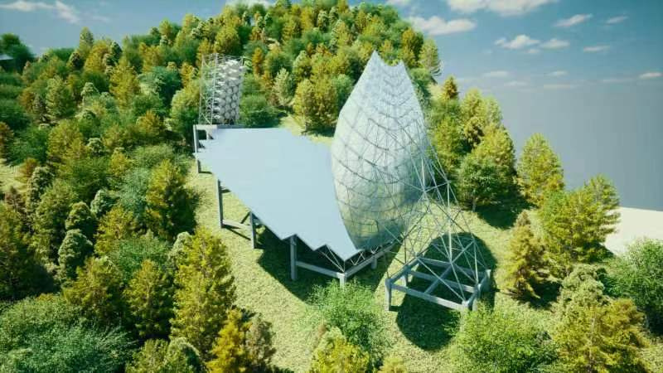
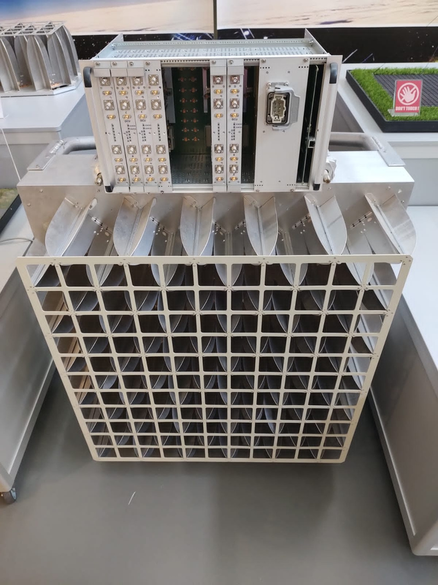
ALLTEC & Metalcard (巴西 - Brazil)
Development of Brazilian metal work in view of scientific demands.
Brazilian industry made horns.
Corrugated horns in Aluminium.
1.7m (diameter) 4.9m (length), 800 kg.
CETC54 (中国 - China)
Dishes with complex geommetry.
40m (diameter).
CETC54
Small aberration.
Clean beams with low level side lobes.
Second alternative for horn design.
ASTRON (荷兰 - Netherlands)
Development of Phased Arrays exclusive for ABDUS
Vivaldi anthenas
Much larger sky covering
Much greater accuracy

Slide 70










Scientific Journalism
Educomunication
Binational Institute
Technical and Scientific School Education
Academic Exchange

Slide 71






APPLIED KNOWLEDGE
Normal labour
Laboratory
The knowledge produced is spread in education and outreach, especially among local population.
The observations are going to be free for perusal for science after analysis of the BINGO/ABDUS team. Universities and institutes from the project will have free access.

Slide 72




What is causing the
cosmic acceleration?
From the Friedmann Eq.

Slide 73

What is causing the
cosmic acceleration?
From the Friedmann Eq.

Slide 74





What is Dark Matter?
Evidences for Dark Matter
Huge amount of evidences indicating that dark matter exists. One of the biggest unsolved, but very well measured, problems in physics.
Observations indicate that DM interacts mainly gravitationally.
So far, we have no (non-contradictory) observations that DM was detected by any non-gravitational mechanism.

Slide 75
Candidates
Neutralinos (higgsino, bins, winos, singlinos)
Axinos
Gravitinos
Sneutrinos
Axions
Sterile neutrinos
4th generation neutrinos
Kaluza-Klein photons
Kaluza-Klein gravitons
Brane world dark matter/D-matter
Little higgs dark matter
Light scalars
Superheavy states (ie. “WIMPzillas”)
Self-interacting dark matter
Super-WIMPs
Asymmetric dark matter
Q-balls (and other topological states)
CHAMPs (charged massive particles)
Cryptons, …
Sypersymmetric

Slide 76




DE/DM Interaction
Cosmological Equation
Each component is not conserved alone anymore.
Many many models in the literature:
Phenomenological (For a classiﬁcation see Koyama, Maartens, Song, 0907.2126; see also Wang, Abdalla, Attrio Barandela, Pavon Rep. Prog. Phys. 2016)
Interaction depending on DM or DE
Constant coupling
or
Time varying coupling
Coupling must be small: constraints from observations!
In general no analytic solution!

Slide 77



Evidence Against ΛDCM?
Baryon Acoustic Oscillations in the Lyα forest of BOSS DR11 quasars.
T. Delubac et al. [BOSS Collaboration] – A&A 574, A59 (2015), arXiv: 1404.1801
From adjusting the BAO peaks and combining with the ΛCDM fiducial values from Planck+ WMAP.
Discrepancy:
1.8σ from Planck+WP;
1.6σ from WMAP9+ACT+SPT.
Conclusion:
Approximately 2σ below the value of DH;
And 2σ above the value of DA;
compared to the ΛCDM prediction.

Slide 78

BINGO: BAO “Hubble diagram”

Slide 79






Forecasts
BINGO project paper VII (Costa et al. 2022)

Slide 80
BINGO ABDUS Science
Baryon Accoustic Oscillations at radio frequency where the original aim of the Project (as it has been devised in 2010). The background idea if to fix, crossing with data from Planck and the future SKA, to enhance the accuracy of Cosmological parameters and eventually probe the dynamics of the Dark Sector
Such that the aim was, however, too ambitious, but ABDUS (Advanced Bingo Dark Universe Studies) may have a better grip into the problem and realize the original aim properly.
Fast Radio Bursts. It was soon realized that even the original BINGO was a proper device to probe transientes. The recente (at that time) discovery of FRB´s became a target, and today is one of the mais subjects for the second BINGO phase, ABDUS.
Transients in general (pulsars, some flaring stars) may be under the scope of BINGO and ABDUS.

Slide 81
ABDUS
The BINGO Project in based on an original design of about 50 metallic (aluminium) horns collecting the sky radiation from a double mirror design. Such a possibility turned out to be very expensive, with little compensation for the price (in fact, the very original proposal mentioned even plaster horns)
A second proposal with chariots to improve covering of the sky (Nyquist) along the Years permited to have a proposal with less horns, thus Much less expensive.
Now, an extraordinary improvement occurs with the Vivaldi antennas

Slide 82


Improvement in ABDUS Project:
BAO“Hubble diagram”
Figs: we present here the expected results for 5 cases: BINGO, SKA 1 and 2, ABDUS (BINGO-HR) using phased arrays and ABDUS with a Mantis like station

Slide 83



Searching for FRBs with BINGO.
The FRB will have an intrinsic flux, which is modelled by our mock catalogue given observed data (Luo et al 2020.)
The noise is obtained given telescope and outrigger characteristics.
A mock catalogue is created for the entire sky.
Effective maximum redshift
S/N

Slide 84


Search for FRBs with BINGO main
Several FRBs will be found, competitive with CHIMES, but no localization is possible with the main telescope only.

Slide 85


Using outriggers to locate the FRBs

Slide 86



Cross Correlations
Several stations, signal to noise given by:
We aim to have three stations at different locations, to be able to cross correlate them.

Slide 87
ABDUS and phased array antennas
Phased arrays consist of closely distributed antenna elements, allowing synthesis of multiple independent beams.
ABDUS proposes the use of phased arrays to boost BINGO's capabilities.
ABDUS-1 involves associating phased arrays with the BINGO focal plane using Vivaldi antennas and beamformers.
ABDUS-2 includes outriggers composed of feed horns and phased-array stations 20 km away to achieve higher angular resolution.

Slide 88



Unit Cell simulation
One unit cell is assumed with four antenna elements, two for each polarization.
We excite two elements of same polarization and run EM simulations on HFSS sofware.

Slide 89



Vivaldi Tile simulation
We simulated a 2x8 array. It correspond to a 35cm x 134 cm tile that will be used on ABDUS project.
The tile is also under tests on ASTRON facilities and will be sent to Brazil after some measurements be finished.

Slide 90


Vivaldi Tile simulation: scanning
The array can be be electronically steered to point in different directions without moving the antennas.
We then present simulations steering in some different directions.

Slide 91
Alargando os Horizontes
Enlarging the Scope
Fast Radio Bursts: the most energetic events in the Universe.
Equivalent to one trillion tons of mass converted into pure energy (E=mc²)
Three days of energy production by the Sun, ejected in one millisecond
Rajadas Rápidas de Rádio: os eventos mais energéticos do Universo.
Equivalem a um trilhão de toneladas de massa convertidos em energia pura (E=mc²)
Três dias de produção de energia pelo Sol, ejetados em um milisegundo
Notes:
22

Slide 92
Alargando os Horizontes
Enlarging the Scope
Alternative Theories of Gravitation
Alternative Theories
Pulsar astrophysics
Distribution of matter in the Universe
Explanation of the processes involved in the explosions that generate FRBs.
Teorias da Gravitação
Teorias Alternativas
Astrofísica de pulsares
Distribuição de matéria no Universo
Explicação dos processos envolvidos nas explosões que geram as RRRs.

Slide 93
Alargando os Horizontes
Enlarging the Scope
Explicação dos processos envolvidos nas explosões que geram as RRRs.
BINGO e as forquilhas
Escrutinando nossos céus: sensoriamento remoto
Explanation of the processes involved in explosions that may generate FRBs.
BINGO and outriggers
Scrutinizing our skies: remote sensing

Slide 94
Alargando os Horizontes: o Papel da Ciência no Mundo Civilizado
Enlarging the Scope:
the Role of Science in
The Civilized World
A economia mundial permaneceu praticamente estagnada desde a pré-história até pouco antes da Revolução industrial ao nível de 160 $ ao ano per capita ($ 2013)
O advento da ciência moderna e seu impacto começa a ser sentido nas Revoluções Industriais
The world economy remained virtually stagnant from prehistory until just before the Industrial Revolution at the level of $160 per year per capita ($2013)
The advent of modern science and its impact begins to be felt in the Industrial Revolutions

Slide 95
Alargando os Horizontes: o Papel da Ciência no Mundo Civilizado
Enlarging the Scope:
the Role of Science in
The Civilized World
1765: Primeira Revolução Industrial, mecanização, Indústria passa agricultura. Termodinâmica!
1870: Segunda Revolução Industrial: avanços tecnológicos, eletricidade, gás, óleo. Equações de Maxwell
1765: First Industrial Revolution, mechanization, Industry passes agriculture. thermodynamics!
1870: Second Industrial Revolution: technological advances, electricity, gas, oil. Maxwell equations

Slide 96
Alargando os Horizontes: o Papel da Ciência no Mundo Civilizado
Enlarging the Scope:
the Role of Science in
The Civilized World
1969: Third Revolution: nuclear energy, electronics, telecommunications, computing. Technological use of quantum mechanics.
21st century: internet. WWW was designed at CERN, where research is performed on elementary particles
1969: Terceira Revolução: energia nuclear, eletrônica, telecomunicações, computação. Uso tecnológico da Mecânica Quântica.
Século XXI: internet. WWW fora concebido no CERN, onde se fazem pesquisas em partículas elementares

Slide 97
Alargando os Horizontes: o Papel da Ciência no Mundo Civilizado
Enlarging the Scope:
the Role of Science in
The Civilized World
A expectativa de vida no Mundo, até o século XVIII/XIX era abaixo de 30 anos, um pouco maior na Europa
O advento da ciência moderna e seu impacto começa a ser sentido
Life expectancy in the world until the 18th/19th century was under 30 years, slightly higher in Europe
The advent of modern science and its impact begins to be felt

Slide 98
Alargando os Horizontes: o Papel da Ciência no Mundo Civilizado
Enlarging the Scope:
the Role of Science in
The Civilized World
Pandemias arrastaram milhões para a morte.
A Gripe Espanhola matou dezenas de milhões. A varíola foi letal até em civilizações antigas. A peste negra dizimou cidades
Pandemias dragged millions to their deaths.
The Spanish flu has killed tens of millions. Smallpox was lethal even in ancient civilizations. The black plague decimated cities

Slide 99
O Projeto BINGO: Educação
The BINGO Project: Education
Henry Luce: The American Century (Life Magazine, 1941):
The 20th century would be the American century, through business, industries and science and the arts.
Carnegie: huge donations to science
Henry Luce: O século americano (Revista Life, 1941):
O Século XX seria o século americano, através dos negócios, indústrias e da ciência e das artes.
Carnegie: imensas doações à ciência

Slide 100
Pensando o Futuro
Shaping the Future
O papel da Universidade
O papel da ciência
As Consequências econômicas
As consequências técnicas
O conhecimento as ciências e as artes
The role of the University
The role of science
The Economic Consequences
The technical consequences
Knowledge of the sciences and the arts

Slide 101
O Radio Telescópio BINGO
Agradecemos seu Interesse e Sua Contribuição!
The BINGO Radiotelescope
Thank you for Your Interest and Your Contribution!

